Slide 1


AMAZON SALES DATA ANALYSIS

Slide 2

Problem Statement:
Sales management has gained importance to meet increasing competition and the need for improved methods of distribution to reduce cost and to increase profits.
Sales management today is the most important function in a commercial and business enterprise. We need to extract all the Amazon sales datasets, transform them using data cleaning and data preprocessing and then finally loading it for analysis.
We need to visualize sales trend month-wise, year-wise and yearly-month wise. Moreover, we need to find key metrics and factors and show meaningful relationships between attributes.

Slide 3

Approach:
The main goal of the project is to find key metrics and factors and then show meaningful relationships between them based on different features available in the dataset.
Data Collection : Imported data from various datasets available in the project using Pandas library.
Data Cleaning : Removed missing values and created new features as per insights.
Data Preprocessing : Modified the structure of data in order to make it more understandable and suitable and convenient for statistical analysis.
Data Analysis : I started analyzing dataset using Pandas, Numpy, Matplotlib and Seaborn.
Data Visualization : Plotted graphs to get insights about dependent and independent variables. Also used Power BI for data visualization.

Slide 4
BENEFITS
OBJECTIVE
Sales management has gained importance to meet increasing competition and the need
for improved methods of distribution to reduce cost and to increase profits. Sales
management today is the most important function in a commercial and business
enterprise.
Help out to make better business decisions.
Help analyze customer trends and satisfaction, which can lead to new and better products and services.
Gives better insight of customers base.
Helps in easy flow for managing resources.

Slide 5
QUICK INSIGHT A quick insight for amazon sales.
93.18M
TOTAL COST
44.17M
TOTAL PROFIT
137.35M
TOTAL REVENUE
9
PRODUCTS
76
COUNTRIES
100
ORDERS
7
REGIONS

Slide 6
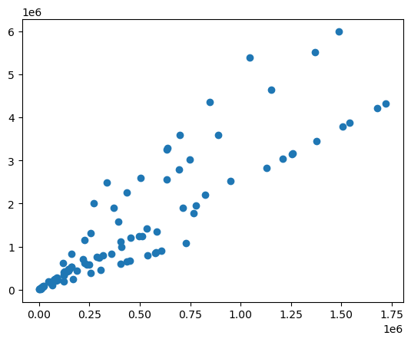
PLOTTING REVENUE AND PROFIT
The scatter plot also suggests that total profit and total revenue are directly proportional to each other.

Slide 7
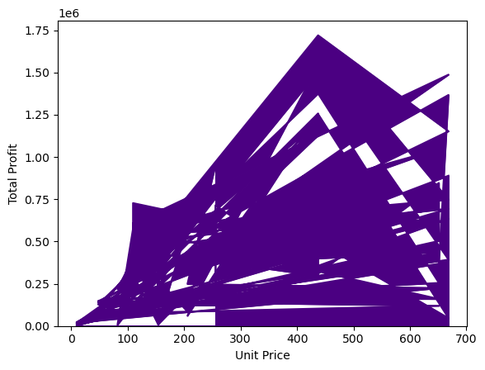
PROFIT BY UNIT PRICE
Maximum profit has been generated in the unit price range of ₹400-₹500.

Slide 8
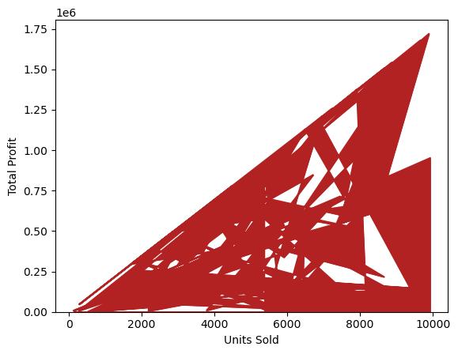
PROFIT BY UNIT SOLD
Maximum profit has been generated when the number of units sold were between 8000 and 10000 i.e. more the number of units sold, more will be the profit generated.

Slide 9
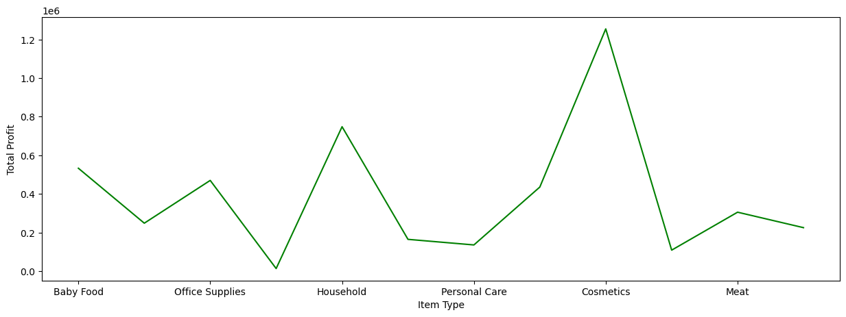
PROFIT BY ITEM TYPE

Slide 10
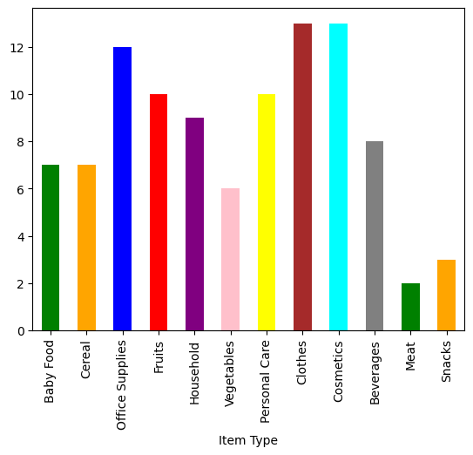
REVENUE BY ITEM TYPE

Slide 11
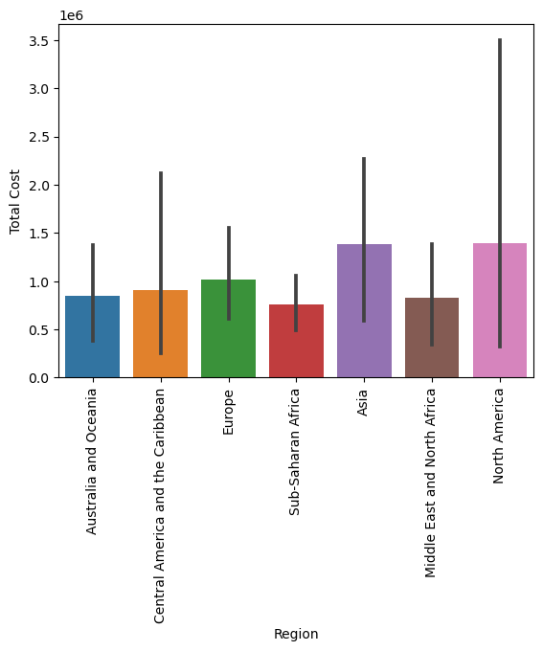
COST OF ITEM BY REGION
Cost of items is maximum in Asia and North America, and minimum in Sub-Saharan Africa.

Slide 12
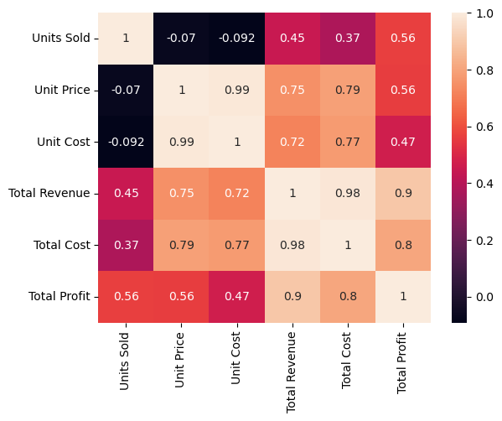
From the above heatmap, we can infer that Total Cost is strongly related to Unit Price, Unit Cost and Total Profit. Units Sold and {Unit Price and Unit Cost} are completely independent.
Number of units sold are independent of price charged per unit of a product and same with cost of a unit which is independent of units sold.
Unit Cost, Unit Price and Total Cost are almost completely independent of Total Revenue.

Slide 13
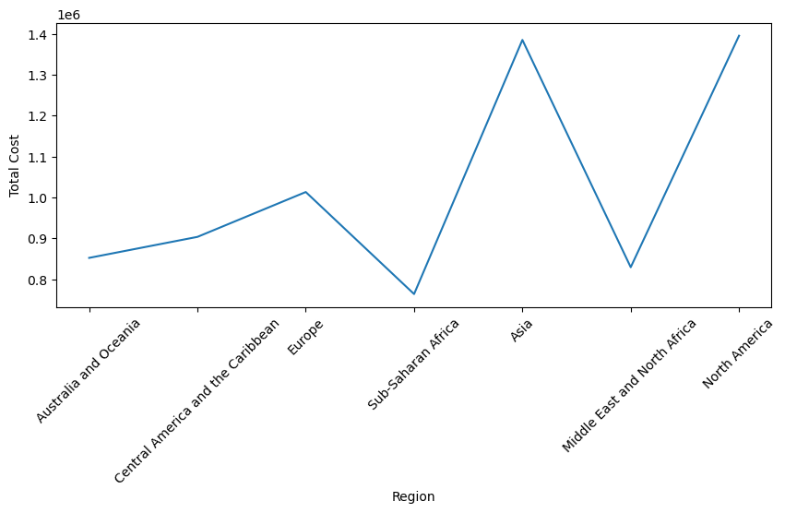
REGION WISE PRODUCT COST
Products have been much more expensive in Asia and North America in comparison to other continents.

Slide 14
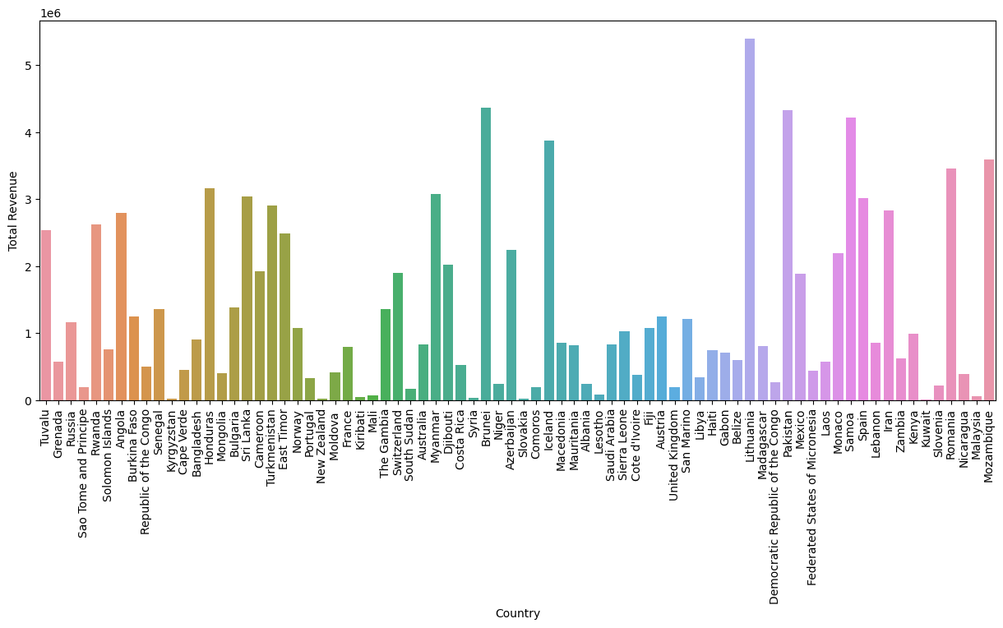
Lithuania is the country where maximum revenue has been generated followed by Brunei.

Slide 15
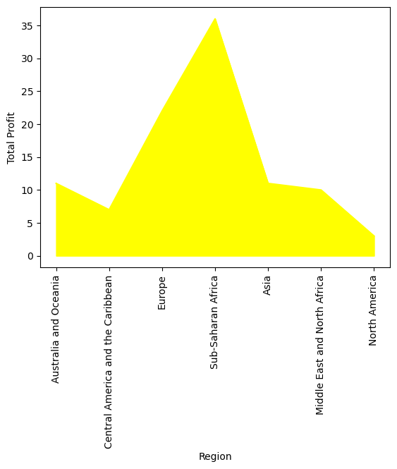
REGION WISE PROFIT

Slide 16
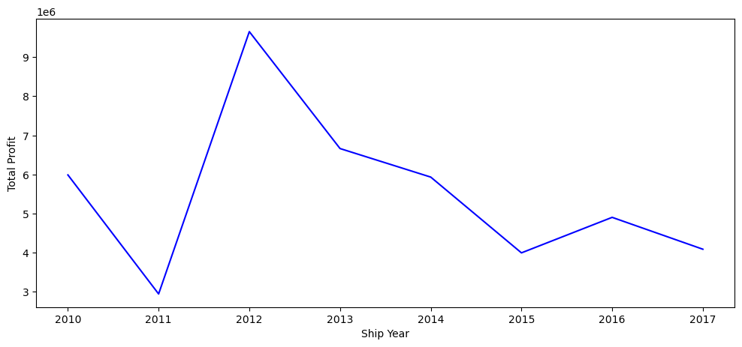
PROFIT BY YEAR

Slide 17
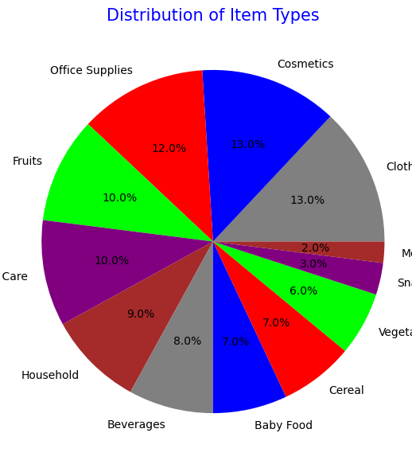
Clothes and cosmetics are the most purchased items while meat and snacks are the least purchased ones.

Slide 18
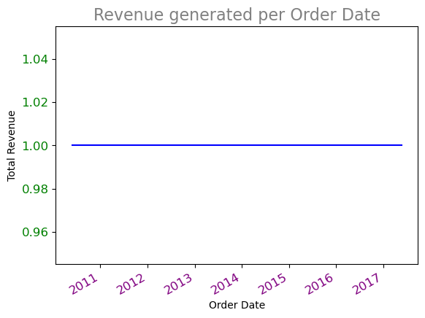
YEAR WISE REVENUE
Total revenue remains constant for every year from 2011 to 2017.

Slide 19

CONCLUSION
The scatter plot also suggests that total profit and total revenue are directly proportional to each other.
Maximum profit has been generated in the unit price range of ₹400-₹500.
Maximum profit has been generated when the number of units sold were between 8000 and 10000 i.e. more the number of units sold, more will be the profit generated.
Cost of items is maximum in Asia and North America, and minimum in Sub-Saharan Africa.
Products have been much more expensive in Asia and North America in comparison to other continents.
Clothes and cosmetics are the most purchased items while meat and snacks are the least purchased ones.
Total revenue remains constant for every year from 2011 to 2017.

Slide 20

DATA VISUALIZATION (AMAZON SALES DATA ANALYSIS)
View in Power BI

Slide 21
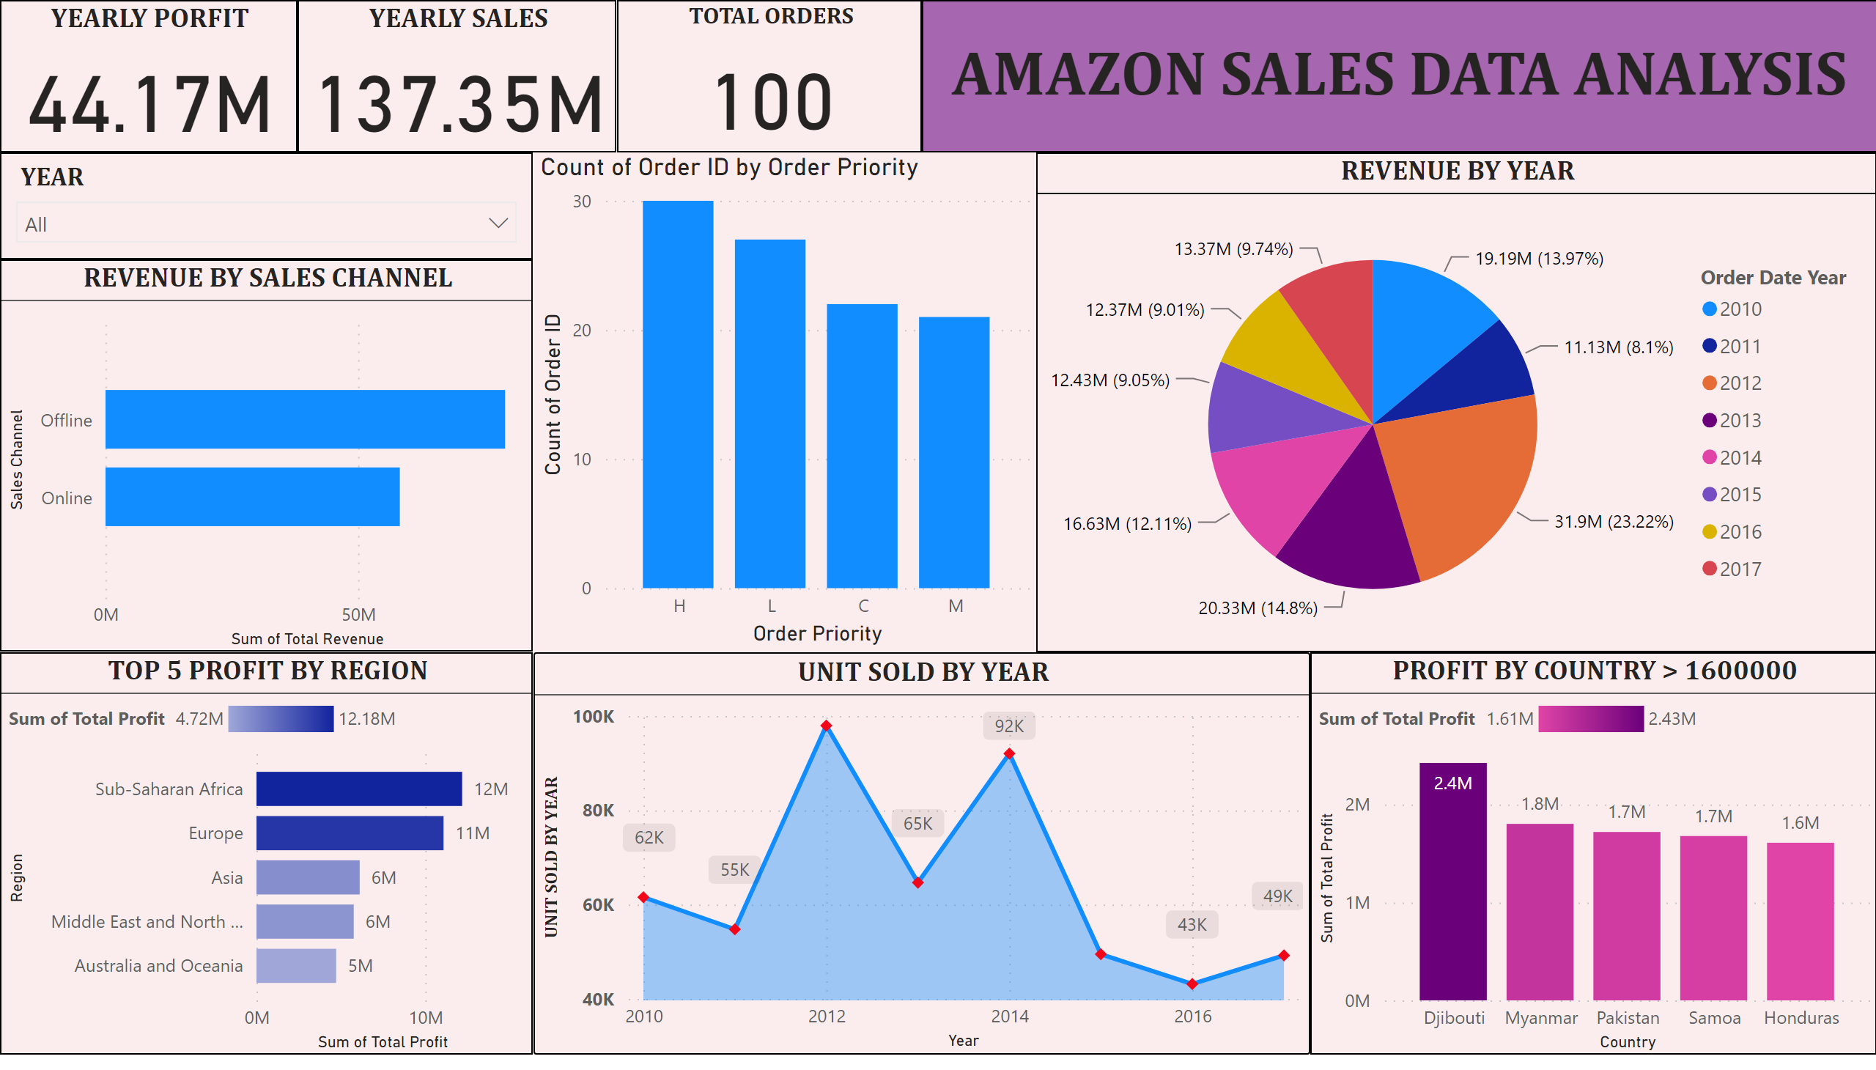
AMAZON SALES REPORT
Notes:
TOP 5 PROFIT BY REGION
No alt text provided
UNIT SOLD BY YEAR
No alt text provided
YEARLY PORFIT
No alt text provided
YEARLY SALES
No alt text provided
TOTAL ORDERS
No alt text provided
REVENUE BY SALES CHANNEL
No alt text provided
REVENUE BY YEAR
No alt text provided
PROFIT BY COUNTRY > 1600000
No alt text provided
slicer
No alt text provided
textbox
No alt text provided
columnChart
No alt text provided

